Slide 1
Linguistics 200, Week 11
Word Order

Slide 2
Thus far we’ve worked on Component 3...
Lexicon
Nouns
Verbs

Slide 3
For Today: Word Order
What is the word order of your:
Noun phrases?
Verb phrases?
Prepositional phrases?
Your sentence?

Slide 4
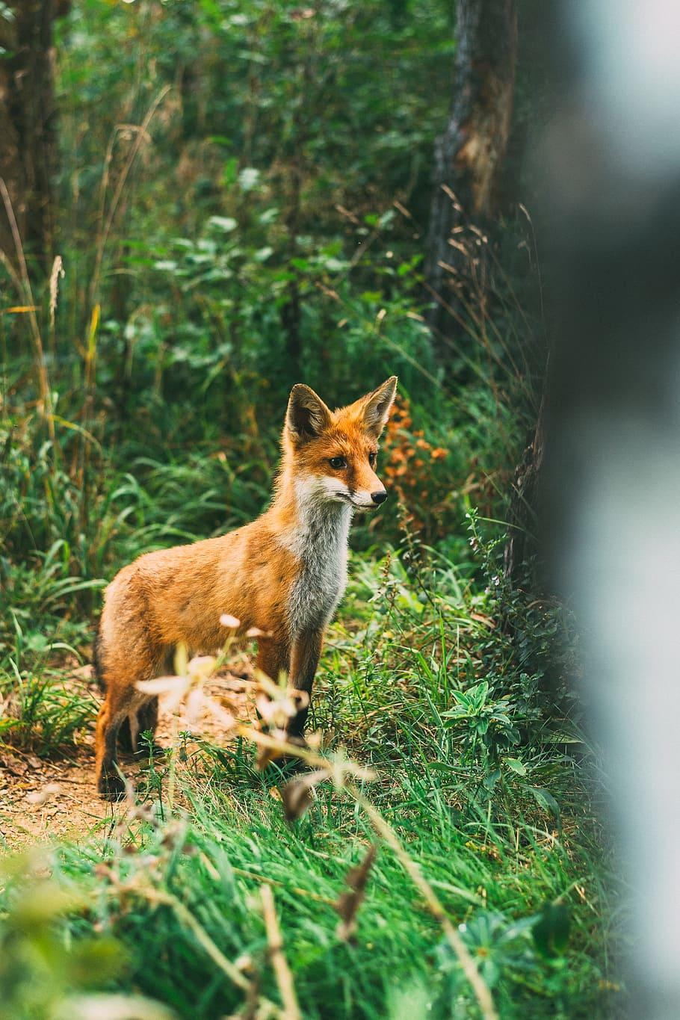
Noun Phrases
Consists of:
Nouns (N) -- this is the “head”
Determiners (a(n), the, this, my; Det)
Adjectives (A)
Prepositional Phrases (PP)
** There is a set word order in English **

Slide 5
This Word Order applies to all Noun Phrases
The quick fox in the forest
Det + A + N + PP

Slide 6
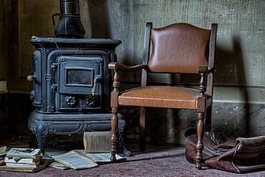
This Word Order applies to all Noun Phrases
That old chair on the floor
Det + A + N + PP

Slide 7
Possible Word Orders in NPs
The fox quick in the forest (Spanish)
Det + N + A + PP
The quick in the forest fox (Japanese)
Det + A + PP + N
Fox quick the in the forest (Welsh)
N + A + Det + PP

Slide 8
Which do you choose? Mɤɧøɴ
“That small metra in the water”
Literal translation:
ɣɤ ɴekowe iɴ ɓɤ-meɴ
“That” “small” “metra” “in-water”

Slide 9
Possible Word Orders in NPs
ɣɤ iɴ ɴekowe ɓɤ-meɴ
That metra small in the water (Spanish)
Det + N + A + PP
ɣɤ ɴekowe ɓɤ-meɴ iɴ
That small in the water metra (Japanese)
Det + A + PP + N
iɴ ɴeke ɣɤ ɓɤ-meɴ
Fox quick that in the forest (Welsh)
N + A + Det + PP

Slide 10
Positions of Head - Where is the noun?
ɣɤ iɴ ɴekowe ɓɤ-meɴ
That metra small in the water (Spanish)
Det + N + A + PP
ɣɤ ɴekowe ɓɤ-meɴ iɴ
That small in the water metra (Japanese)
Det + A + PP + N
iɴ ɴekowe ɣɤ ɓɤ-meɴ
Metra small that in the water (Welsh)
N + A + Det + PP
Transitional
Head Final
Head Initial

Slide 11
How to choose?
Suffixes vs. Prefixes
Languages that have suffixes tend to be head-final
Languages that have prefixes tend to be head-initial
ku-ta-ʛu
you-it-drink

Slide 12
Positions of Head - Where is the noun?
ɣɤ iɴ ɴekowe ɓɤ-meɴ
That metra small in the water (Spanish)
Det + N + A + PP
ɣɤ ɴekowe ɓɤ-meɴ iɴ
That small in the water metra (Japanese)
Det + A + PP + N
iɴ ɴekowe ɣɤ ɓɤ-meɴ
Metra small that in the water (Welsh)
N + A + Det + PP
Transitional
Head Final
Head Initial

Slide 13
Which do you choose?
Prefixes = head-initial!
iɴ ɴeke ɣɤ ɓɤ-meɴ
Metra small that in the water (Welsh)
N + A + Det + PP

Slide 14
How to choose?
2. Don’t have suffixes or prefixes (or have a mixture of the two)?
These languages tend to be head-initial or transitional.

Slide 15
It’s your turn!
Work with your group to determine the order of words in your noun phrase and translate “that quick fox in the woods” (or something similar)
ɣɤ iɴ ɴekowe ɓɤ-meɴ
That metra small in the water (Spanish)
Det + N + A + PP
ɣɤ ɴekowe ɓɤ-meɴ iɴ
That small in the water metra (Japanese)
Det + A + PP + N
iɴ ɴekowe ɣɤ ɓɤ-meɴ
Metra small that in the water (Welsh)
N + A + Det + PP
Transitional
Head Final
Head Initial

Slide 16
Verb Phrases
Consists of:
Verbs (V) -- this is the “head”
Noun Phrases (NP)
Prepositional Phrases (PP)
** There is a set word order in English **

Slide 17
This Word Order applies to all Noun Phrases
Eyes the man from the grass.
V + NP + PP

Slide 18
Which do you choose? Mɤɧøɴ
“Hears a dinosaur from the sand.”
Literal translation:
won we ɧaŋ-ɭa
“hears” “(a) dino” “from-sand”

Slide 19
Positions of Head - Where is the verb?
won we ɧaŋ-ɭa
hear(s) (a) dino from-sand (Welsh)
V + NP + PP
ɧaŋ-ɭa we won
From-sand (a) dino hear(s) (Japanese)
PP + NP + V
Head Initial
Head Final

Slide 20
Which do you choose? Mɤɧøɴ
won we ɧaŋ-ɭa
hear(s) (a) dino from-sand (Welsh)
V + NP + PP
ɧaŋ-ɭa we won
From-sand (a) dino hear(s) (Japanese)
PP + NP + V
Head Initial
Head Final

Slide 21
It’s your turn!
Modify your word order following what you’ve already done with your NPs, and translate:
“Hears a man from the sand.”

Slide 22
Prepositional Phrases
Consists of:
Prepositions (P) -- this is the “head”
Noun Phrase (NP)
** There is a set word order in English **

Slide 23
Prepositional vs. Postpositional
“In bed” *“Bed in”
“On the way” *“The way on”
“From my nose” *“My nose from”
“With a spoon” *“A spoon with”
*“Ago 20 years” “20 years ago”
Head Initial
Head Final

Slide 24
Which do you choose? Mɤɧøɴ
Must be head-initial (already chose that route!)
Location: in Undersplash ɓɤ-wisiyesi
Source: from Undersplash ɧaŋ-wisiyesi
Instrument: with Chomper ti-çampa
Possession: Chomper’s xɤ-çampa

Slide 25
Which do you choose?
Extend the work you’ve done with NPs & VPs to choose a PP word order. Then translate the following sentence:
“From the water”

Slide 26
Sentences
3 most common word orders:
VSO Kicks the boy the ball. - Head-Initial
SOV The boy the ball kicks. - Head-Final
SVO The boy kicks the ball. - Transitional

Slide 27
Sentences
3 most common word orders:
VSO Kicks the boy the ball.
SOV The boy the ball kicks.
SVO The boy kicks the ball.

Slide 28
Which do you choose? Mɤɧøɴ
Must be head-initial (already chose that route!) - VSO
ʀuɗe çampa meɴ. “Chomper gives water” (generally) →
ʀɤnʀuɗe çampa meɴ we. “Chomper gives water to the dinosaur.”
onʀuɗe çampa meɴ iɴ. “Chomper gives water to the metra.”
sønʀuɗe çampa meɴ ɓiŋ. “Chomper gives water to the seaweed.”

Slide 29
Which do you choose?
Extend the work you’ve done with NPs, VPs, & PPs to choose a sentence word order. Then translate the following sentence:
“That small person in the water hears a dog from the sand.”

Slide 30
Y’ALL YOU CAN TRANSLATE YOUR FINAL PROJECT NOW

Slide 31
Linguistics 200, Week 11
Word Order

Slide 32
Review
Headedness:
Prefixes, Suffixes, Mix
Head-Initial, Head-Final, Transitional
Noun Phrases
Verb Phrases
Adpositional Phrases
Sentences

Slide 33
Dorgon Word Order: Let's Review the Grammar
Nominals
Number
Case
Verbs
Tense
Mood
Valence
Incorporation

Slide 34
Dorgon Word Order – What do we choose?
Nominals
Number
Case
Verbs
Tense
Mood
Valence
Incorporation

Slide 35
Next Time – We'll translate some Dorgon

Slide 36
In Class Activity – Let's Translate Constances's Language: ŋɶbu
Word Order: Transitional
Nominals:
Number: sg., du., tr., pa., pl.
Case: subj., DO, IO, 'before', 'after', 'from', 'with, 'of'
Articles; 'a', 'the'
Verbs:
Person/number
Tense
Mood
Voice

Slide 37
In Class Activity – ŋɶbu
Let's translate together:
I stand before a mountain. The fire burns the crops.

Slide 38
In Class Activity – ŋɶbu
With your groupmates:
Compose a sentence in ŋɶbu with at least one noun, one adjective, and one verb.

Slide 39
Now return to your language
Translate a sentence like:
I stand before a mountain. The fire burns the crops.
What grammar do you lack to do?

Slide 40
Linguistics 200, Week 11
Word Order

Slide 41
Question 15
How does your language treat questions? Are question words moved to the beginning of the sentence (through so-called “wh-movement”), or are they left in the normal position of nouns & adverbs? (Be sure to define each word / phrase that you've invented for your language, which you cite)

Slide 42
Remember – Component 3 due Monday!
Any other questions about what you need to do?

Slide 43
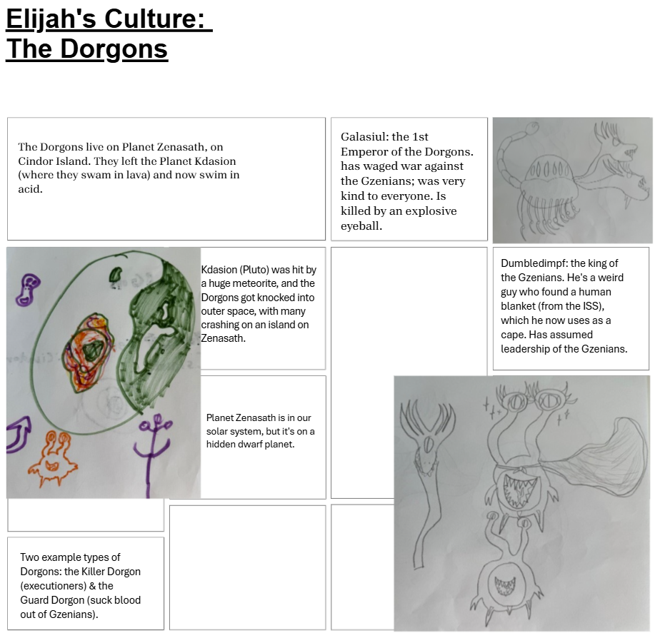

Slide 44
In Class Activity – Let's Translate Pxsinunr
Behold! I am Galasiul. I am the greatest of all (the) Dorgons.
As emperor, all Dorgons bow at my feet.
(The) Killer Dorgons lay their weapons at my feet.
(The) Guard Dorgons hide their fangs in my magnificent presence.
I have travelled a great distance, from Kdasion to this small island on Zenasath.
Behold! There is Dumbledimpf. He is a small idiot. He wears a blankie with shame.
Behold! An eye of fire comes to me.

